Slide 1
Chapter - 1 What is “GIT”
Version Control and Git Basics

Slide 2
Version control : What is it ?
A version control system (also known as a Revision Control System) is a repository of files, often the files for the source code of computer programs, with monitored access. Every change made to the source is tracked, along with who made the change, why they made it, and references to problems fixed, or enhancements introduced, by the change.
The Repository
At the core of the version control system is a repository, which is the central store of that system's data. The repository usually stores information in the form of a filesystem tree—a hierarchy of files and directories. Any number of clients connect to the repository, and then read or write to these files. By writing data, a client makes the information available to others; by reading data, the client receives information from others

Slide 3
The Working Copy
A version control system's value comes from the fact that it tracks versions of files and directories, but the rest of the software universe doesn't operate on “versions of files and directories”. Most software programs understand how to operate only on a single version of a specific type of file. So how does a version control user interact with an abstract—and, often, remote—repository full of multiple versions of various files in a concrete fashion? How does his or her word processing software, presentation software, source code editor, web design software, or some other program—all of which trade in the currency of simple data files—get access to such files? The answer is found in the version control construct known as a working copy.
A working copy is, quite literally, a local copy of a particular version of a user's VCS-managed data upon which that user is free to work. Working copies appear to other software just as any other local directory full of files, so those programs don't have to be “version-control-aware” in order to read from and write to that data. The task of managing the working copy and communicating changes made to its contents to and from the repository falls squarely to the version control system's client software.

Slide 4
GIT – BASICS
Understanding git (version control system)

Slide 5
GIT in a nutshell
The whole idea of GIT is to take a snapshot of your project at different time intervals so that if anything wrong happens, one can restore the project’s state at a particular time in the past.
Git is also useful in situations when there are two people editing the same file. They may pull the same file, edit it, commit changes and then push it to remote server. Now, If they are using FTP then it is possible that they may overwrite each other changes. But if they are using Git then it will try to merge these changes.

Slide 6
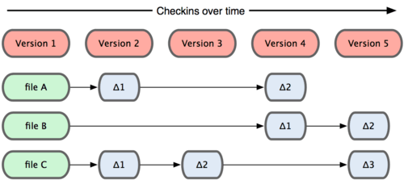
GIT takes snapshots
The major difference between Git and any other VCS (Subversion and friends included) is the way Git thinks about its data. Conceptually, most other systems store information as a list of file-based changes. These systems (CVS, Subversion, Perforce, Bazaar, and so on) think of the information they keep as a set of files and the changes made to each file over time, as illustrated in Figure.

Slide 7
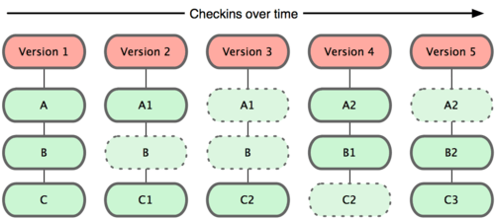
Every time you commit, or save the state of your project in Git, it basically takes a picture of what all your files look like at that moment and stores a reference to that snapshot. To be efficient, if files have not changed, Git doesn’t store the file again—just a link to the previous identical file it has already stored.

Slide 8
Some main points about GIT
Nearly Every Operation Is Local : Most operations in Git only need local files and resources to operate — generally no information is needed from another computer on your network. This aspect makes GIT very speedy, Because you have the entire history of the project right there on your local disk, most operations seem almost instantaneous
Git Has Integrity : Everything in Git is check-summed before it is stored and is then referred to by that checksum. This means it’s impossible to change the contents of any file or directory without Git knowing about it. This functionality is built into Git at the lowest levels and is integral to its philosophy. You can’t lose information in transit or get file corruption without Git being able to detect it.
Git Generally Only Adds Data :When you do actions in Git, nearly all of them only add data to the Git database. It is very difficult to get the system to do anything that is not undoable or to make it erase data in any way.

Slide 9

The Three States
Git has three main states that your files can reside in: committed, modified, and staged.
Committed means that the data is safely stored in your local database.
Modified means that you have changed the file but have not committed it to your database yet.
Staged means that you have marked a modified file in its current version to go into your next commit snapshot.
This leads us to the three main sections of a Git project:
The Git directory
The working directory
The staging area.

Slide 10
Let’s get it started !
Download + Install + Setup + configure + use

Slide 11
Configuring GIT

Slide 12
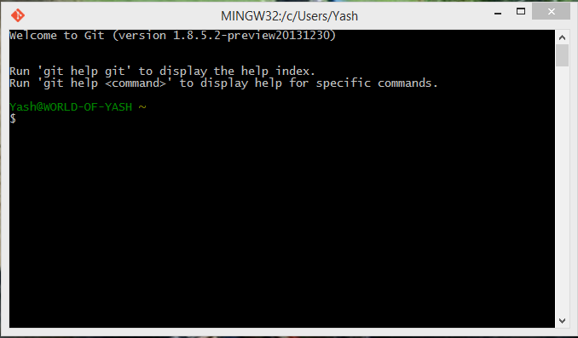
1) Open GIT BASH

Slide 13
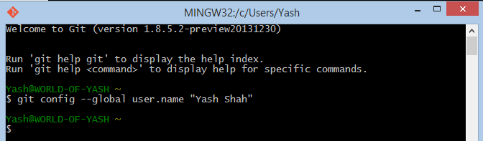
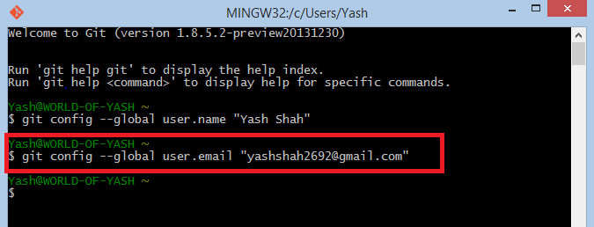
2) Set Username 3) Set Email
2.
3.

Slide 14
Creating “Repository”

Slide 15
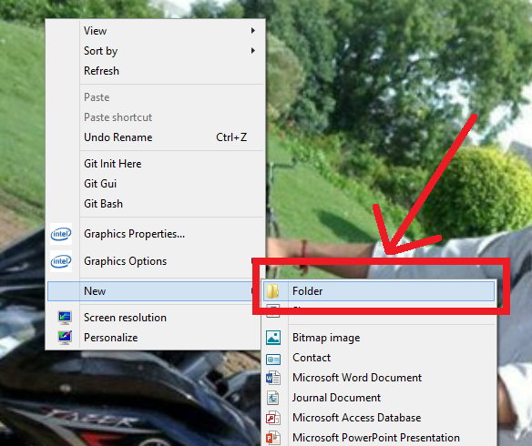
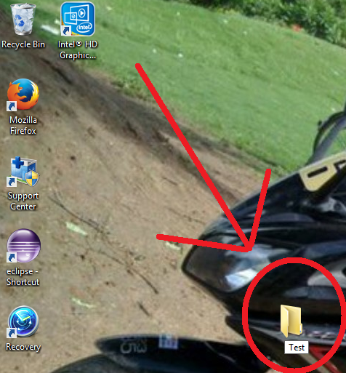
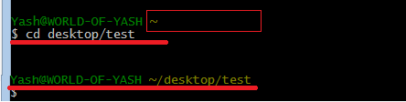
Create a folder.
Change directory to that folder.
1.
As you can see, I have created a new folder - TEST on desktop.
So I’ll change my directory to desktop/test.
2.

Slide 16

Initiate Git repository.

